Slide 1



Initial project pitch
Zulsar Batmunkh, Saadiyah Husnoo, Dana Mukusheva & Dong Hyug Lim
6.170 Software Studio
November 3rd, 2014

Slide 2
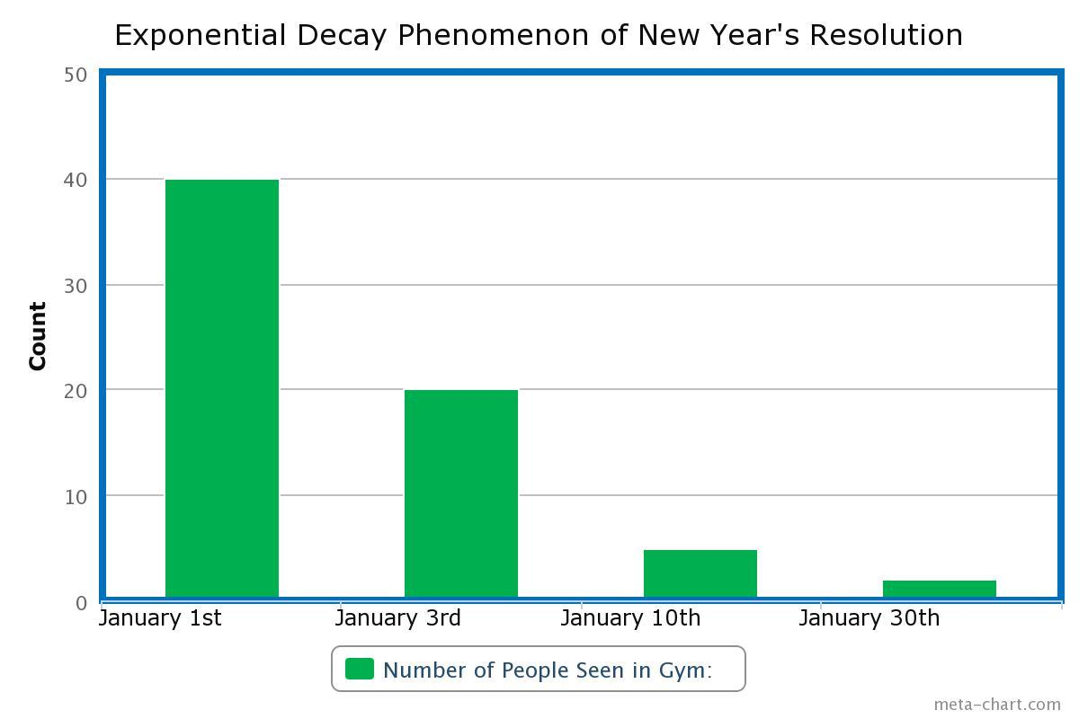

Slide 3


Slide 4





Design overview
places bet
Task failed
task completed

Slide 5

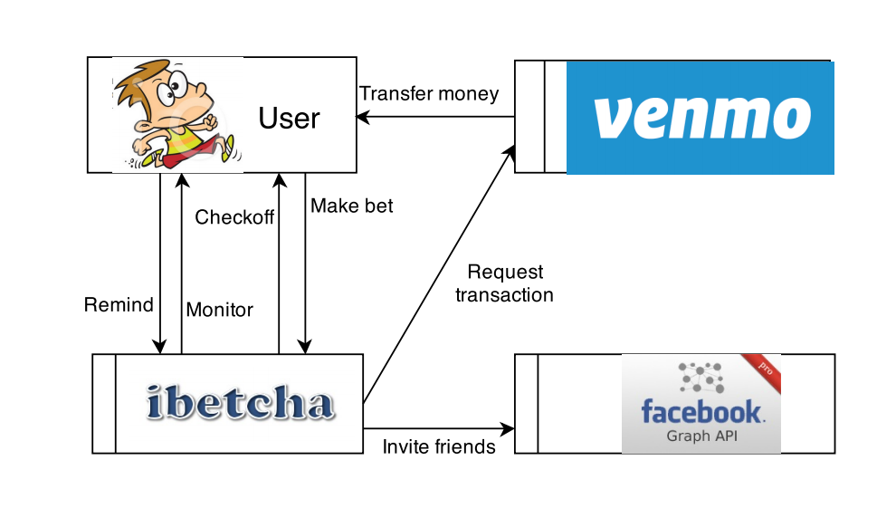
Concepts
Monitor - a user chosen to confirm the
completion/failure of the bet
Bounty - amount of money put on bet
Context

Slide 6
Challenges and Risks
Design
Checkoff protocol
Money hoarding
Implementation
User authentication
Secure money transfer
Concurrent checkoffs
Development
No ibetcha friends
Mongoose
Monitors
Venmo
Facebook

Slide 7

Questions?

